Slide 1
EDA Overview
Enterprise Data & Analytics
November 2023

Slide 2



ED&A
ED&A Reporting Offering
Go To Market
Productivity
OPEX
SALES/TCV
HEADCOUNT
EXPENSES
REVENUE
UTILIZATION
REVENUE
CONTRACT WORKERS

Slide 3



ED&A
ED&A Team Skills
ED&A is composed of senior professionals with +8 years of experience, working under our Data, Analytics and Reporting departments.
Analytics
Reporting
Data
Responsible for gathering and extracting data, cleansing and modelling for our projects.
Responsible for business analysis data transformation & reconciliation
In charge of data quality & advance analysis, as well as leading the GenAI internal initiative.
Creates data visualizations following the project requirements.
Team consisting of 3 people, who are Computer and Telecommunications Engineers.
Main Skills:
SQL
GIT
Snowflake
Databricks
Two professionals in Business Computing and Economics.
Main Skills:
Alteryx
Other Skills:
SQL
Power BI
Team members (3) who are Data Scientists and Machine Learning professionals.
Main Skills:
Python
SQL
GIT
GenAI
Team consisting of 2 people who are Business Intelligence and Big data professionals.
Main Skills:
Power BI
SQL
Other skills:
Celonis

Slide 4












ED&A
ED&A Data Sources
Financials/OPEX
Go To Market
Productivity
Business Specifics
USBU POD Reporting
USCAN OE Metrics
MedSci Opportunity Tracker
GSE Monthly Account Dashboard
LAUNCH Revenue Tracker
Commercial Solution Resource Management Dashboard
CSIH
ITS Data Warehouse
Fee Revenue and EBITDA
Actuals vs Forecast vs Plan
Compensation
OPEX YoY growth
Portfolio alignment
Third Party Expenses
TCV / Opportunity Count and Revenue by Account, Offering, PIC, Profit Center, Asset…
Win/Lost Rates
Sales/Revenue actuals vs plan
Pipeline Metrics
Headcount Management
Contigent workers
Span of Control
Utilization
Cost & Revenue
Wordcount per month
Revenue, Gross Margin and total costs
Turn around time
Number of closed projects
% of time on projects
System Connections
Hyperion Cubes
(HFM, MRA, PBF)
CRM and PSA
MDM Hierarchies
Flat Mapping Tables /Manual Files
Data lake Connection – ECDP
Hyperion Cubes
(PBF)
*Data coming from Workday is manually extracted by partners.

Slide 5




ED&A
ED&A Results
8
6.8K
Initiatives in Production
During 2023, ED&A has delivered 8 overall initiatives, each of them including several deliverables.
Total views
ED&A has delivered 10 Reporting Dashboards across IQVIA BUs.
Individualised mails delivered to 14 PICs on biweekly base.
444
$318M
Unique Users
Active Dashboard users.
Additional +260 users added for Launch Revenue Tracker (10/30 go-live)
YoY Rev Growth
All Dashboards delivered by ED&A and actively in use have seen an increase in Revenue compared to prior year results.

Slide 6
ED&A
Go To Market Projects
2023

Slide 7



ED&A
Launch Revenue Tracker
Project Status: Completed
BENEFITS
Optimize commercial launch opportunities by:
Informing both short and long-term asset-based planning and client engagement strategy.
Identifying further client engagement opportunities through identification of potential white spaces.
Allowing both global and local IQVIA teams to build coordinated client engagement strategies at global and local level.
GOAL
Create a Launch Revenue Tracker for the Launch Excellence Team to track IQVIA financial performance by Account, Client´s Asset and Launch Offering across Pharma priority launches.
Tracker applies a customer centric view to the way sales teams look at financial data by overlaying the IQVIA Launch Offering Framework.
Data Sources
KPIs
TCV (Won, Lost, Pipe)
Revenue In Hand
Opportunity Count (Total, Won, Lost, Pipe)
Strike Rate, Hit Rate
Penetration Rate
Share of Addressable Opportunities
Dashboard
Manual Inputs
Launch Offering Framework
Priority Asset Master List

Slide 8
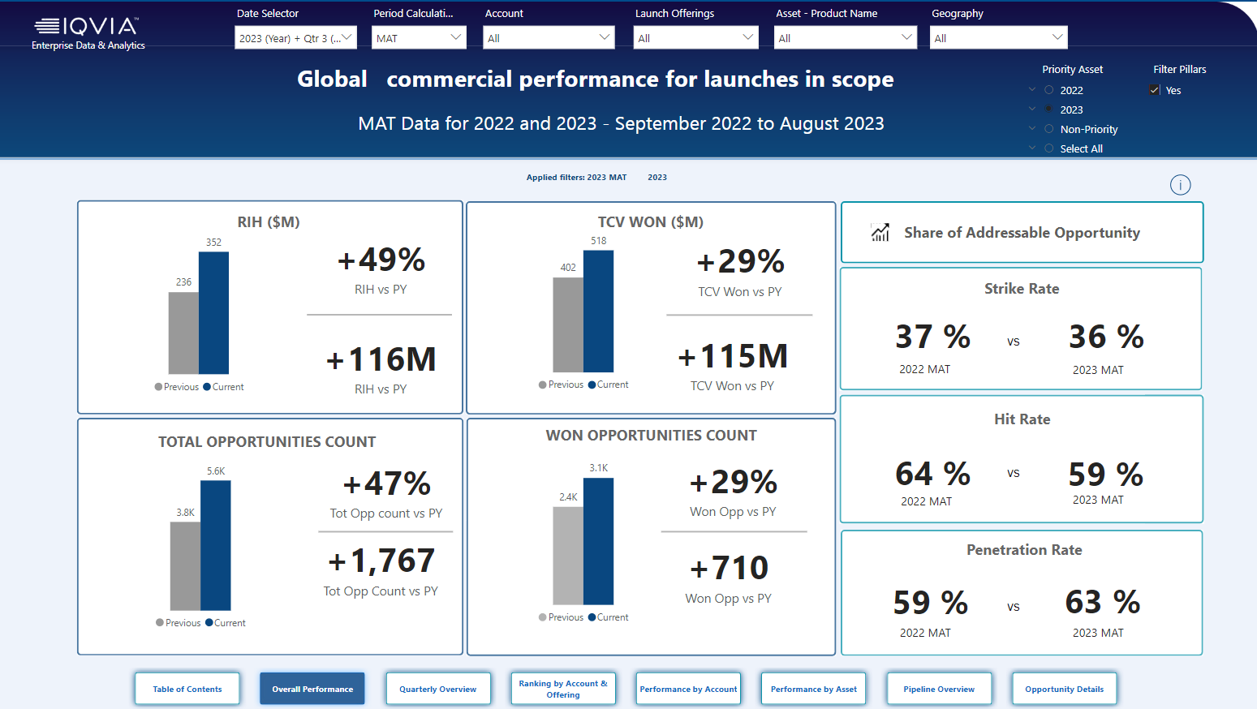
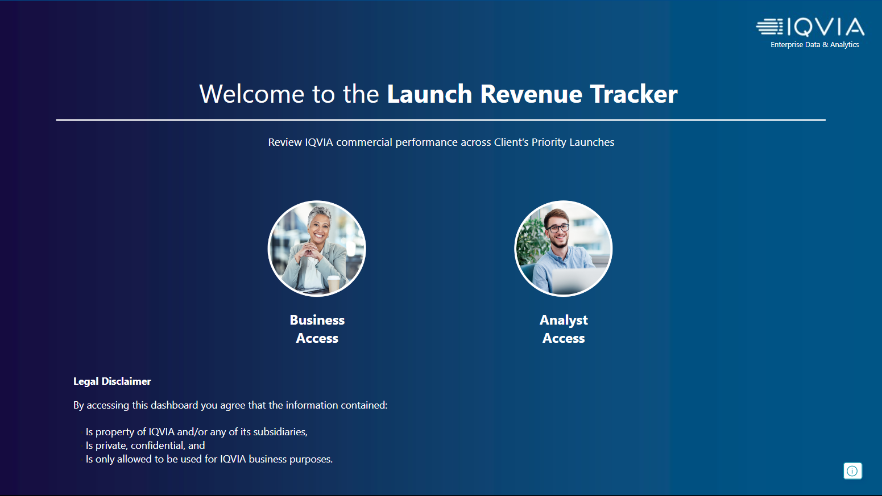
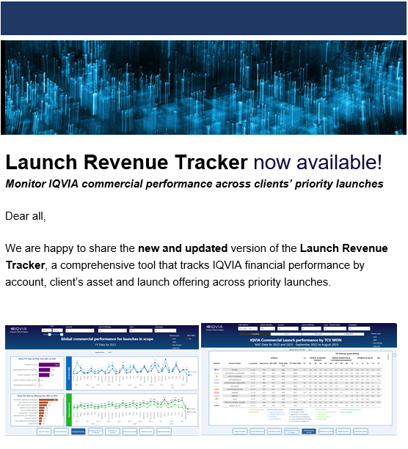
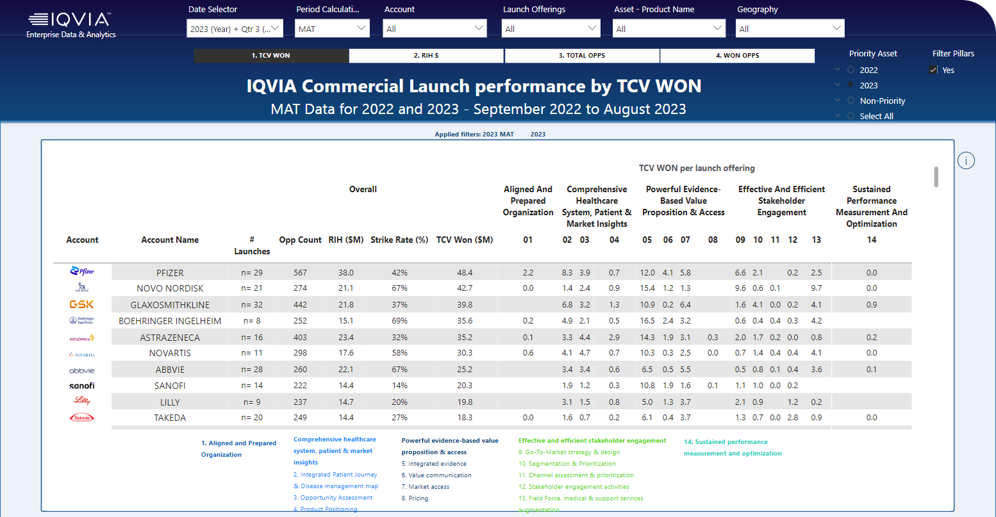
ED&A
Launch Revenue Tracker
Link to Dashboard
Landing Page with two views: Business Access for business users with an executive view on Launch Data and Analyst Access with more granular level data.
Announcement has been shared on 30.10 with +260 IQVIA employees

Slide 9
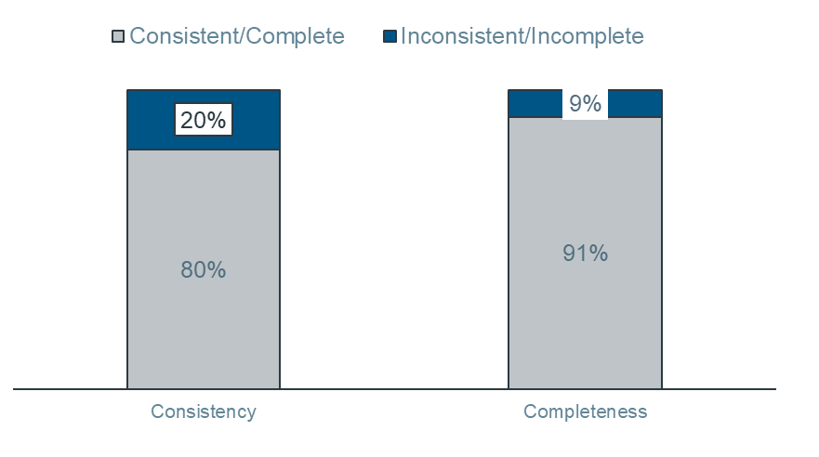
ED&A
Data Quality: Enhancing CRM Integrity
Delivered a data quality analysis on Global CRM data, as well as an Asset Cleansing Dashboard for the Launch team.
GOAL
Ensure data integrity within CRM by identifying and addressing inconsistencies and missing values.
Actions
CRM Champions Meeting: Scheduled to showcase data quality dashboard to existing Champions group.
Notification System: CRM Team investigating automated alert solution to identify opportunities where close date is in the past.
Automated Cleaning: ED&A Team has already corrected 28.8k opportunities, impacting $6.6bn TCV and a corresponding $482M in revenue.
EDA Enhancements: Continuous improvement based on stakeholder feedback.
SCOPE
CRM data (2016 - current); 990k opportunities.
FINDINGS
Inconsistent and Missing Data identified.

Slide 10
ED&A
GSE&I Monthly Dashboards
Project Status: Completed
BENEFITS
Eliminated manual efforts to produce monthly report
Reliable data for strategic decisions and incentive process
Reduction from 80 Dashboards (before they had an excel file per account) to a single Power-BI.
Increased efficiency and reduced reporting error and discrepancies
Data available sooner & increased access of teams to relevant data.
Expanded user base to Client Partners & Strategic EBP accounts.
GOAL
Create a centralized report for IQVIAs top 80 accounts to serve as a single source of truth for Customer financial data to help GADs, GKAMs, Client Partners, MDs and Executive Leadership with decision making.
Additionally, Dashboard is intended to feed into incentives process making data availability and accuracy critical to the business.
Data Sources
KPIs
Overview (Actuals vs Target)
Sales & Revenue
Pipeline
Win Loss Ration & Reasons
Past Due
IQVIA Revenue Rankings
Dashboard
Manual Inputs

Slide 11
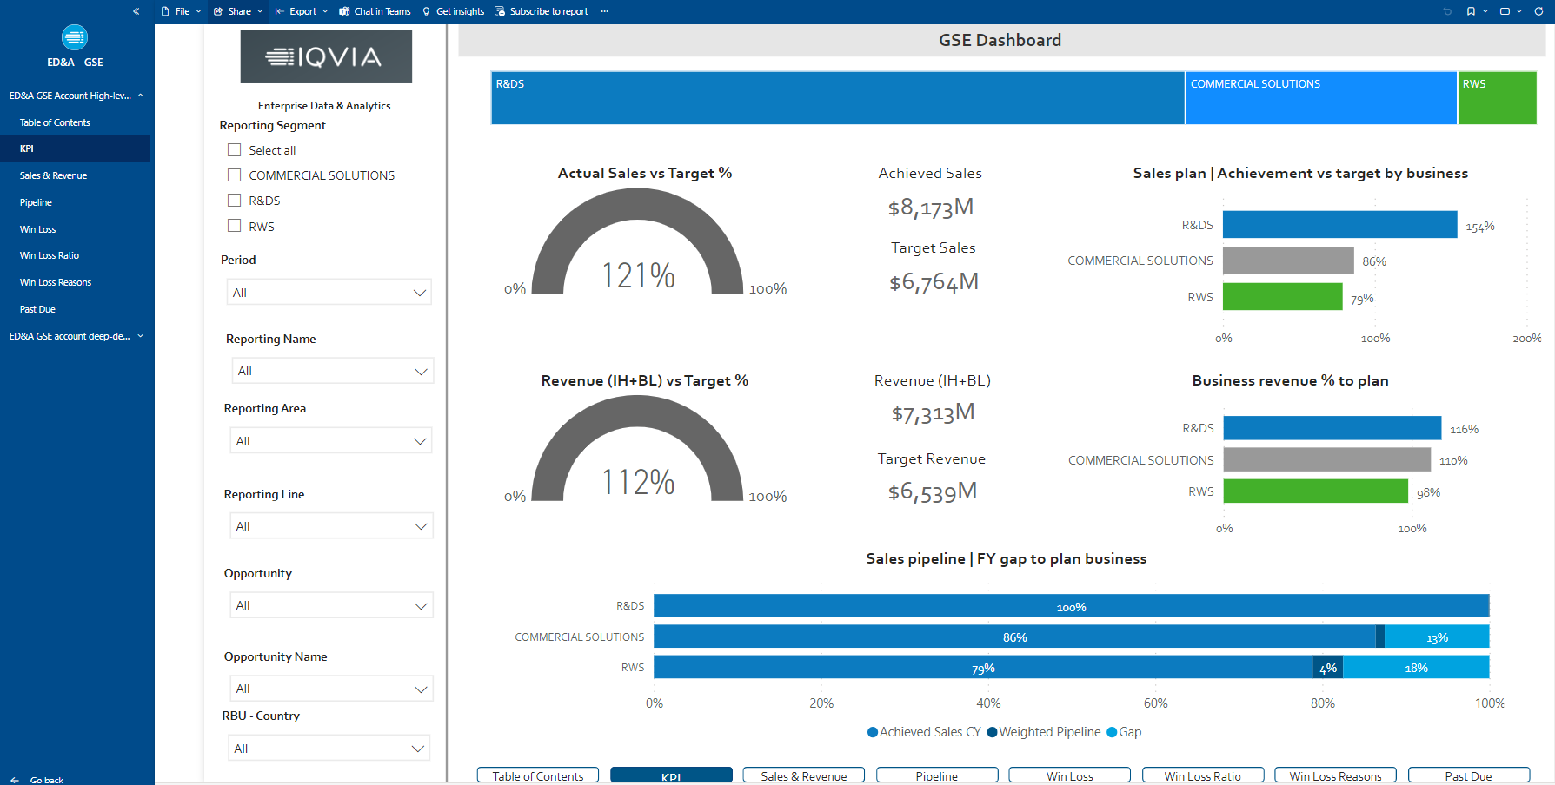
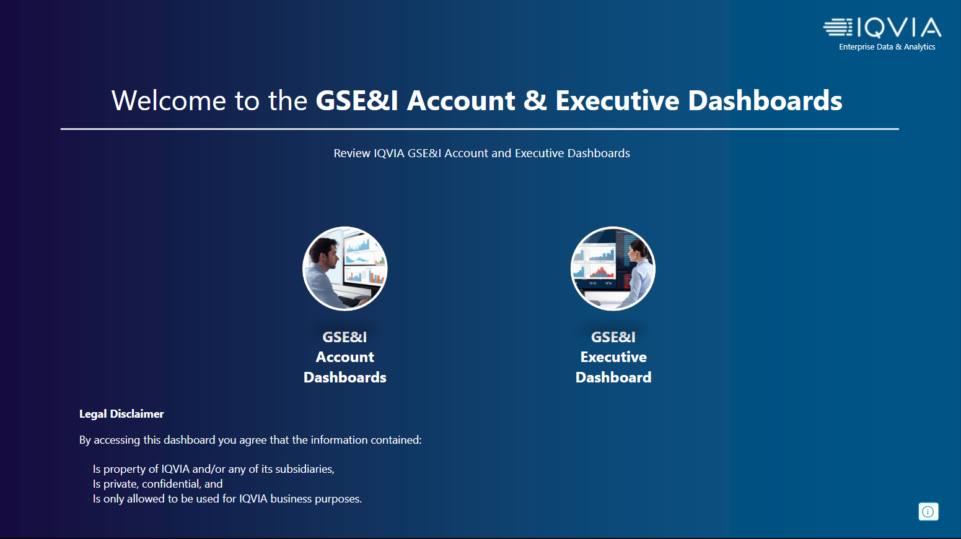
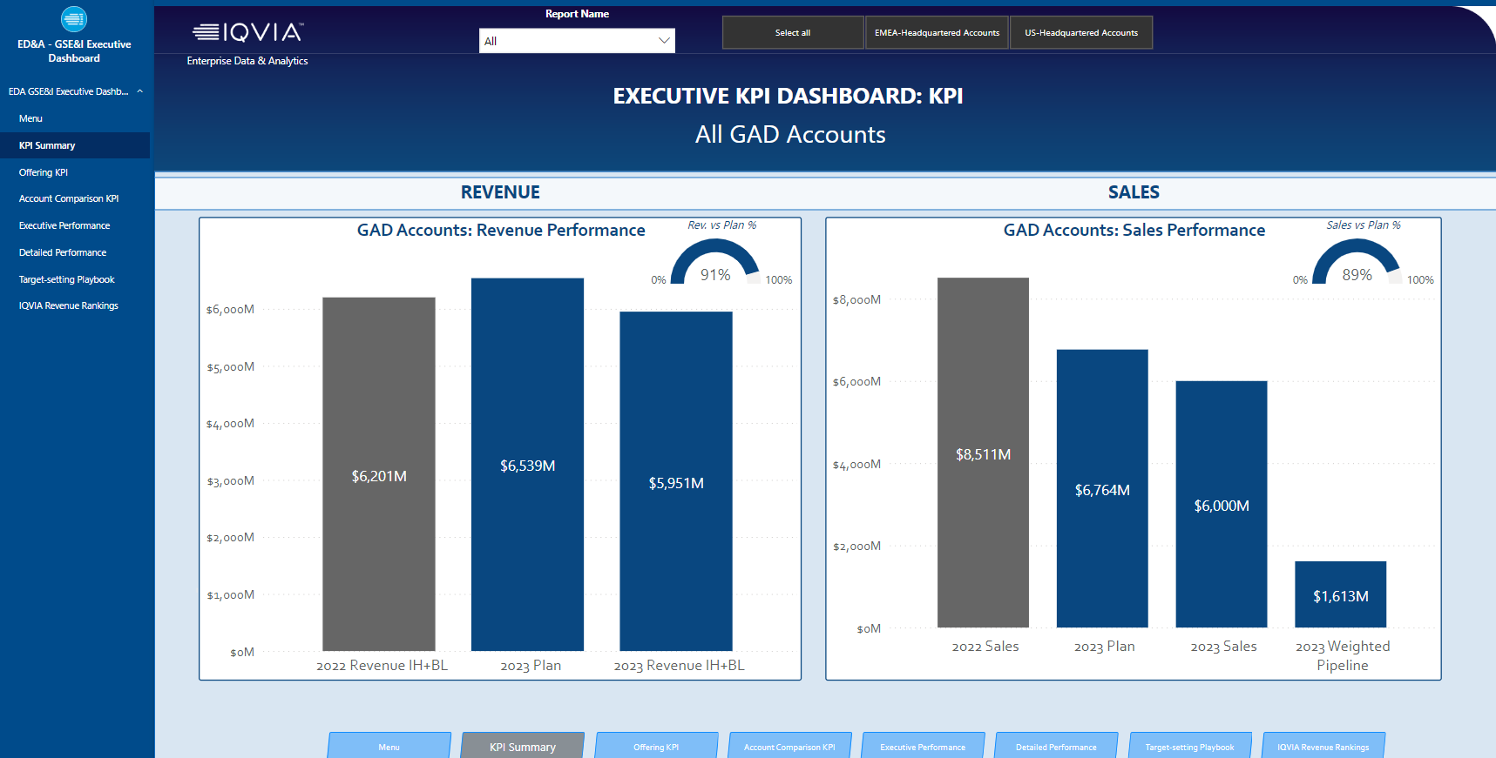
ED&A
GSE&I Monthly Dashboards
Link to Dashboard
Landing Page with two views: GSE&I Account Dashboard with visibility into IQVIA Top 80 accounts and GSE Executive Dashboard with a more executive view on EMEA & US GAD Accounts
GSE&I Account Dashboard – 80 Top Accounts
Aggregate view of all accounts and possibility of selecting individual accounts
GSE&I Executive Dashboard – EMEA and US GAD Accounts
More than 350 users with access granted to the Dashboard

Slide 12
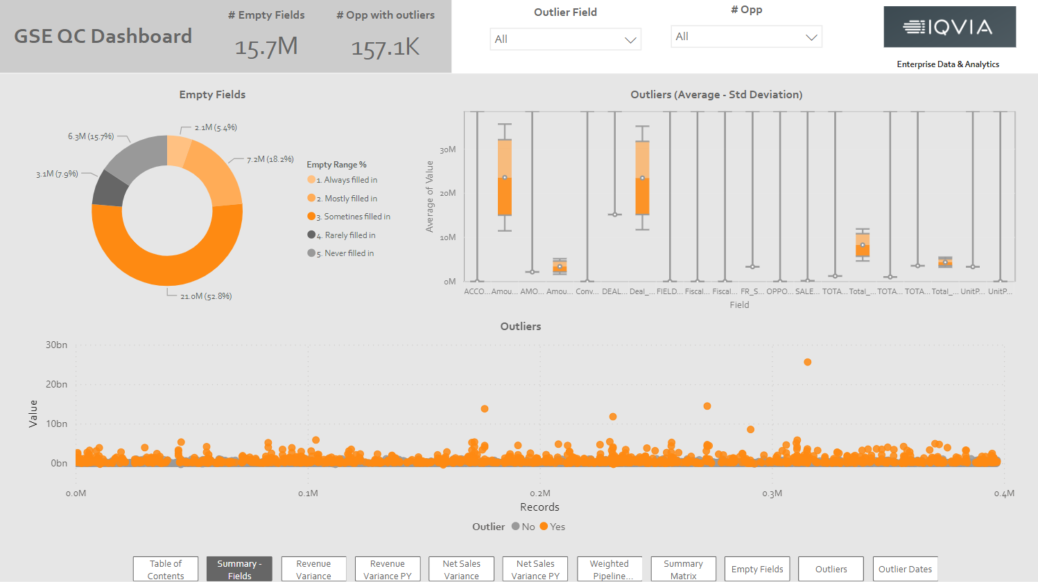
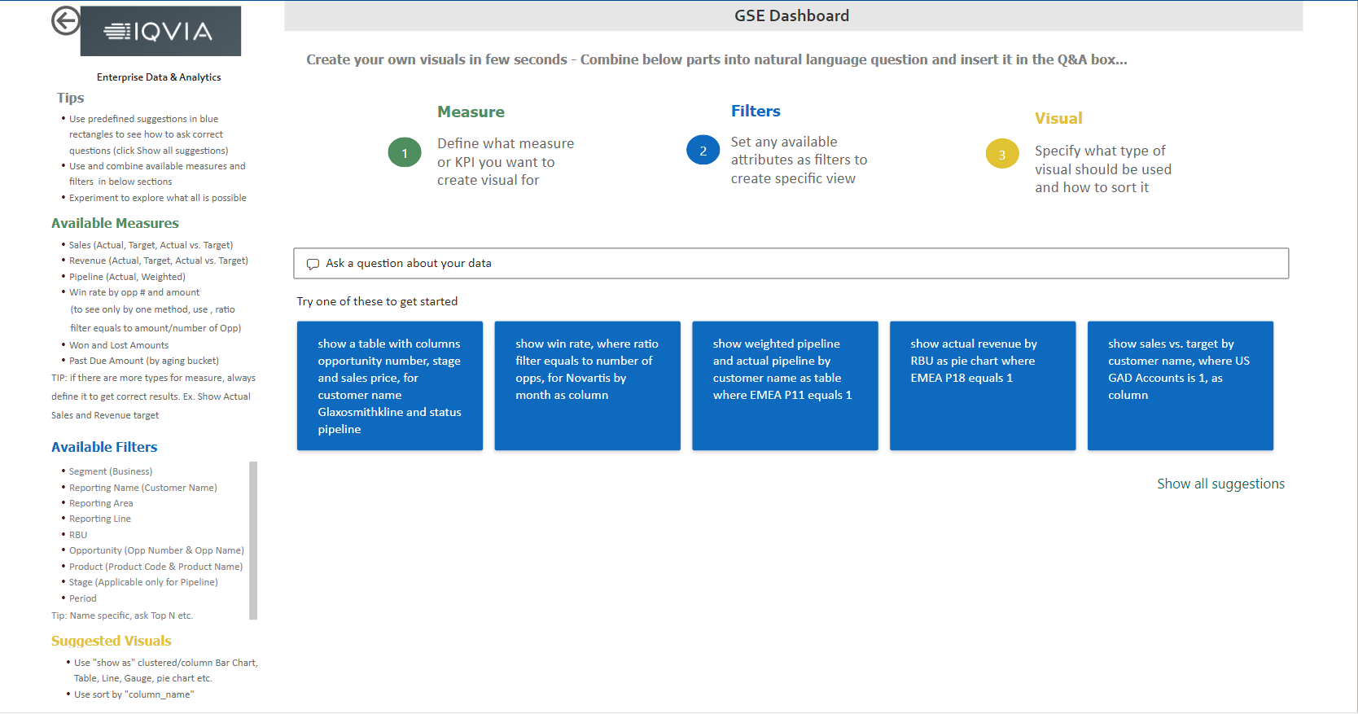
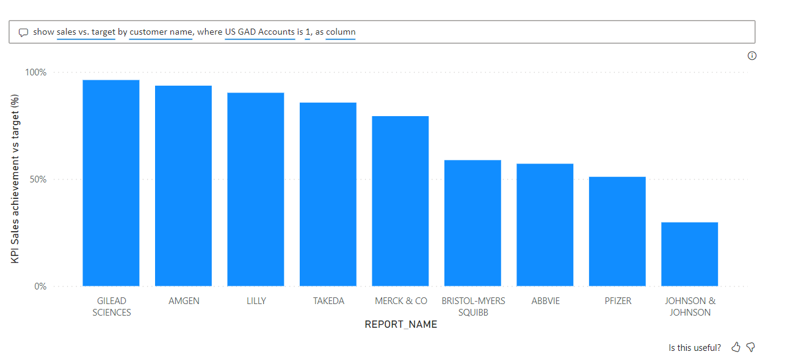
ED&A
GSE&I Monthly Dashboards
Besides Main Dashboard we have also delivered to GSE&I team other products such as a Quality Dashboard and a Q&A tool.
Quality Dashboard
Q&A Tool
Quality Dashboard was built for GSE&I team so they could control their data quality and increase dashboard accuracy.
Dashboard reports on sales & revenue variances from month to month (to detect if there have been very big variations) and on empty fields and outliers so that team can correct these opportunities in the source system.
Q&A tool is embedded within main Dashboard and enables the user ask questions on the data behind and create its own visuals based on the data they are interested on.

Slide 13
ED&A
MedSci Opportunity Tracker
Project Status: Completed
BENEFITS
Improve Go To Market Strategy – increase sales win rate & identify new revenue streamlines
Visibility on MedSci area performance
Weekly real time reporting for Leadership and PICs.
Clear KPIs & metrics
Individualized reporting for ~ 20 unique PICs (distributed every 2 weeks via email)
GOAL
Create an Opportunity Tracker Dashboard to enable MedSci Team to take strategic decisions and improve Go to Market Strategy.
Dashboard also intends to make MedSci data available to all team members, each PIC having a Dashboard with their own results.
Data Sources
KPIs
Opportunity Overview
TCV (Won, Lost, Pipe)
Revenue
Won/Loss Opportunities
Win Rate
Top 15 clients
Dashboard

Slide 14
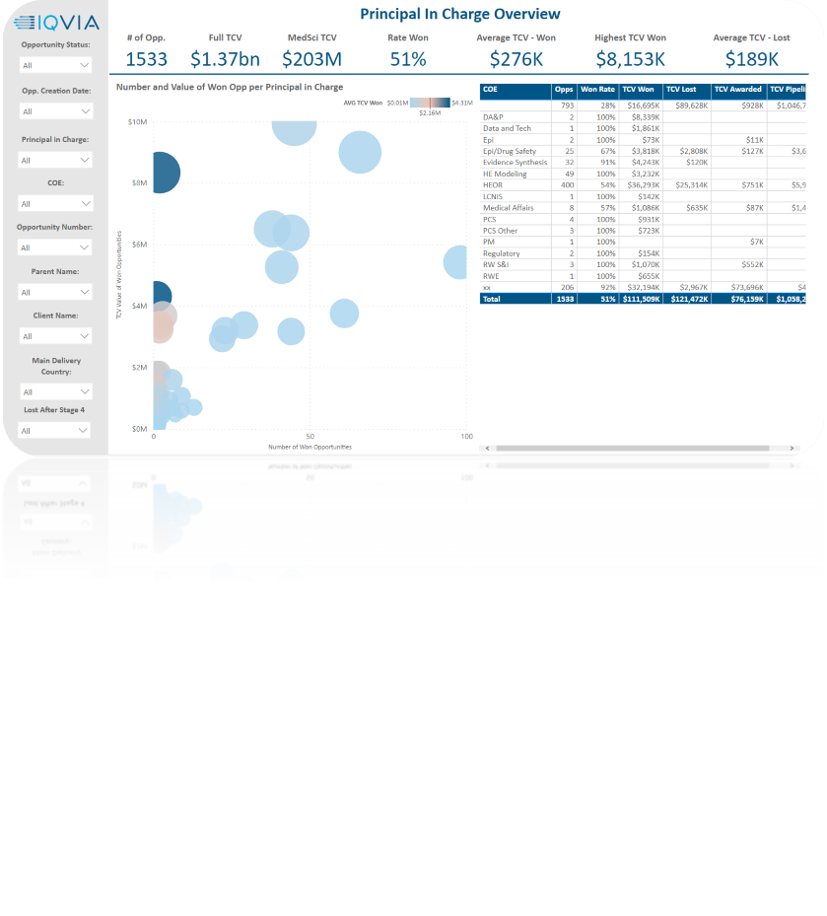
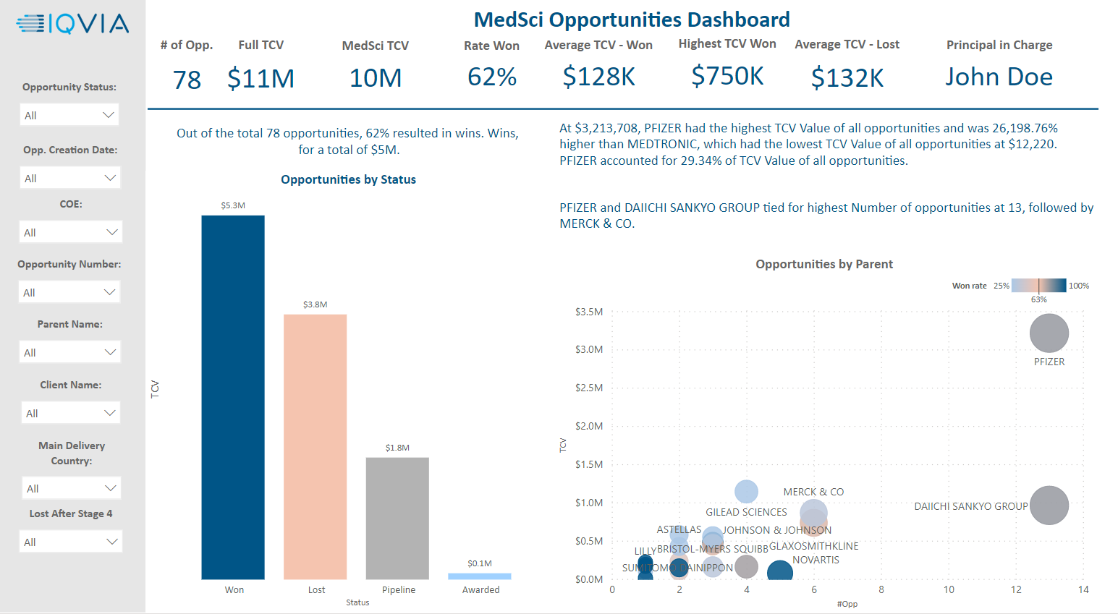
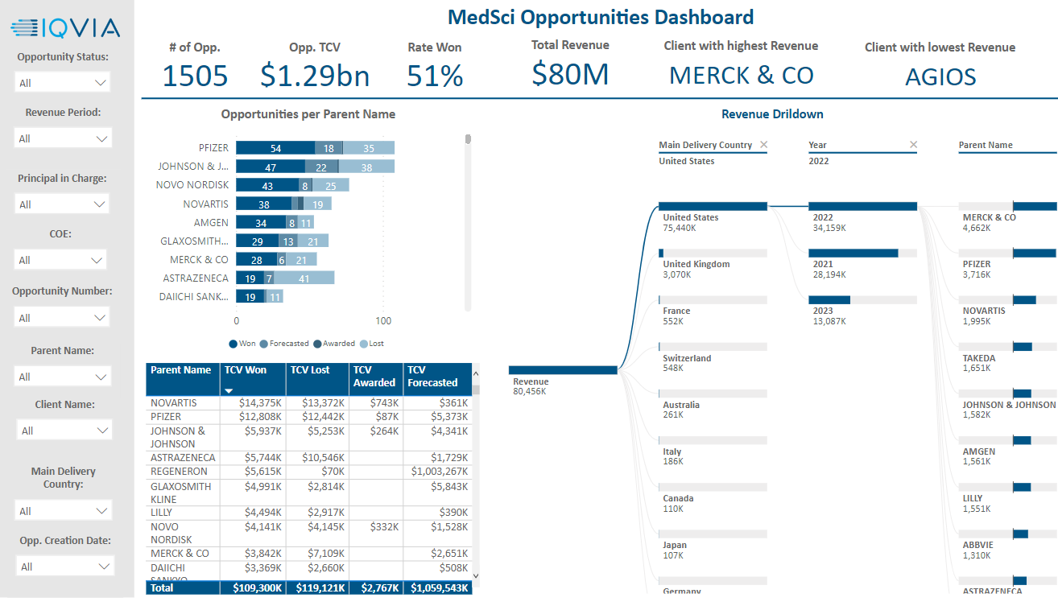
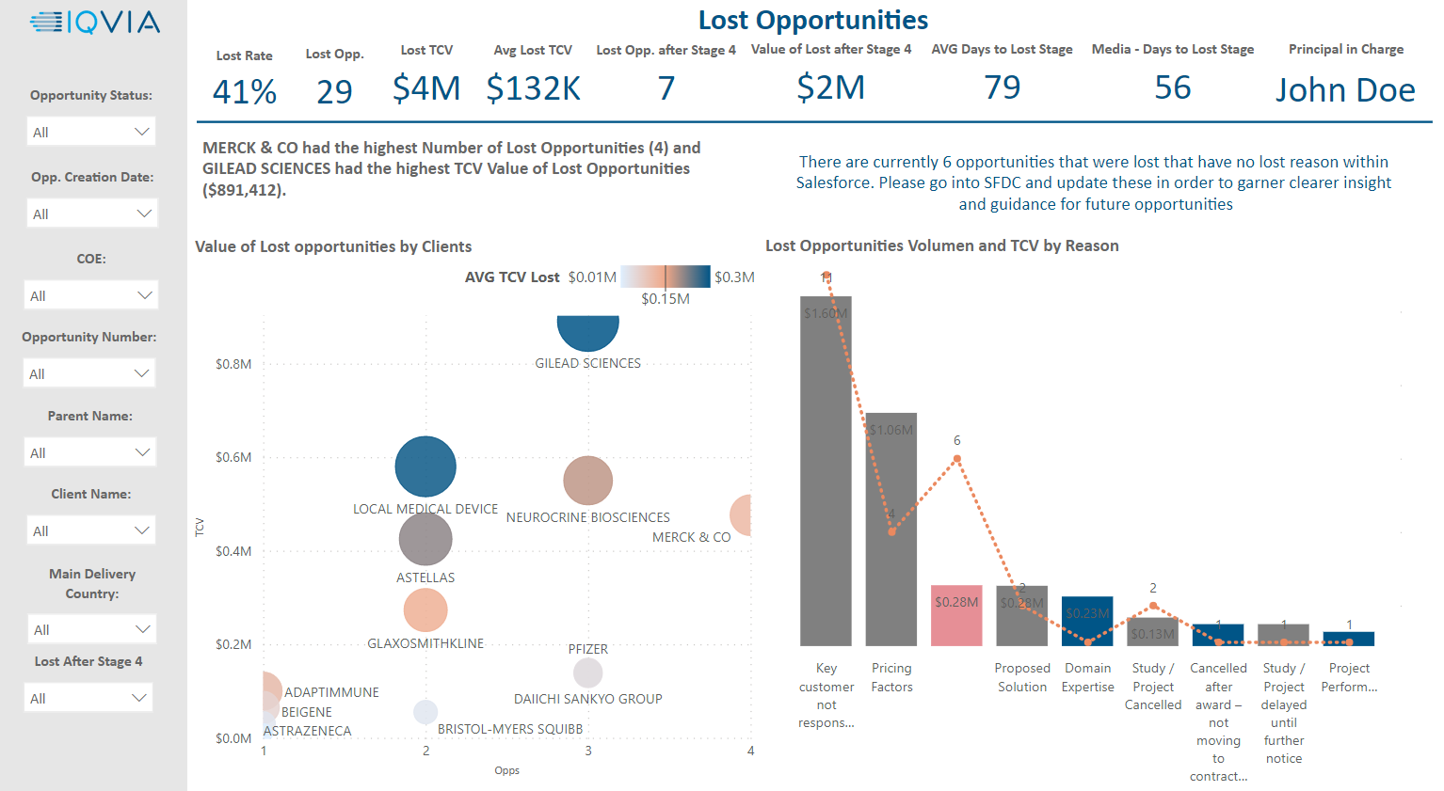
ED&A
MedSci Opportunity Tracker
Link to Dashboard
General Overview
PIC Overview
Dashboard with an overview for full MedSci team available for Leadership team
Dashboard with an overview per each individual PIC available to each PIC
Dashboard focus on Opportunities lost after Stage 4 where proposal has already been made to client
Dashboard enables to filter #Opportunities, TCV and Revenue generated by different elements: Date, PIC, Client, Delivery Country, COE…

Slide 15
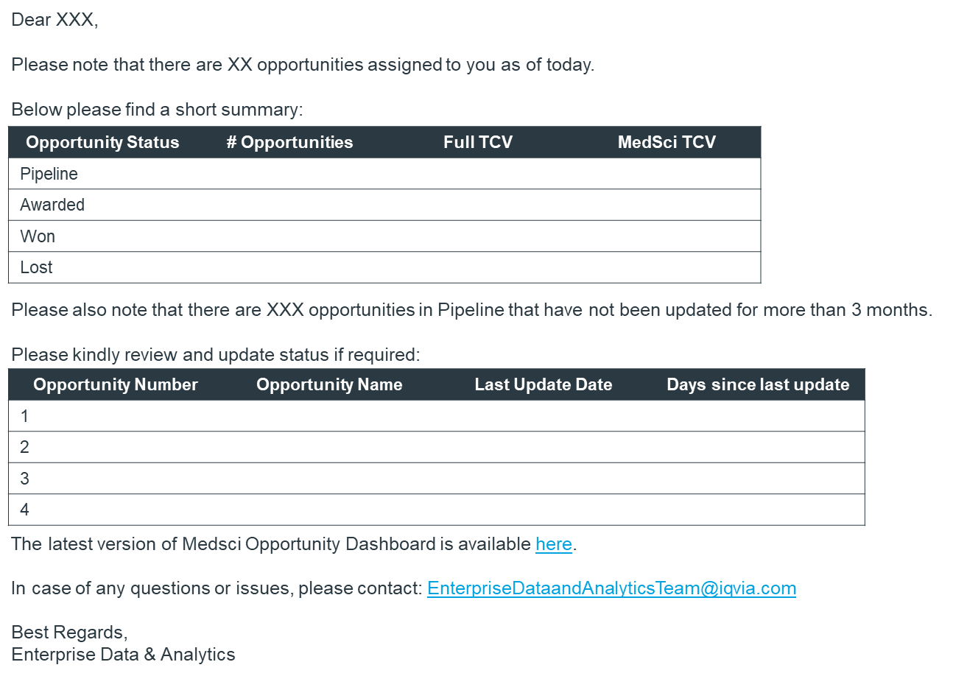
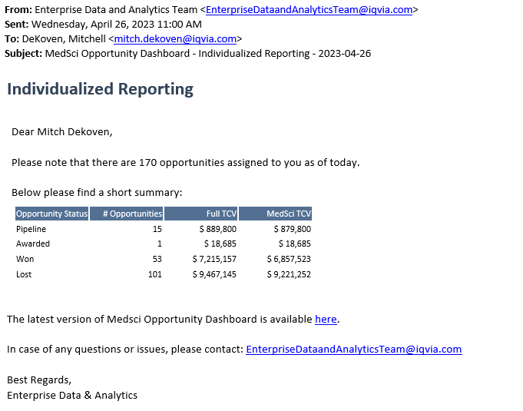
ED&A
MedSci Opportunity Tracker
We are sharing individualized emails with MedSci team every 2 weeks, where we share with each PIC the number of opportunities assigned to them and highlight the ones that have not been updated in more than 3 months so that they can take action.
E-mail Template
Example

Slide 16
ED&A
Productivity Projects
2023

Slide 17
ED&A
Resource Management Dashboard
Project Status: In Development
BENEFITS
Centralized report including GBU & non-GBU employees.
FTE analysis for current and previous years (going back to 2019)
Analysis for Contingent Workers
Cost & Revenue historic details
Utilization trend by product, manager and employee
GOAL
Create a centralized Resource Management Dashboard for the Commercial Solutions team, leveraging the solution already deployed by RWS (Headcount Management Dashboard), that will allow to have consistent RM process across all business areas improve utilization and efficiency.
AMESA Resource Management Dashboard is under assessment.
Data Sources
KPIs
Current FTE Overview
Organizational Structure
Span of Control
Contingent Workers
Historic Headcount
Revenue & Costs
Utilization
PBF
Link to Dashboard
*Data coming from Workday is manually
extracted by partners.

Slide 18
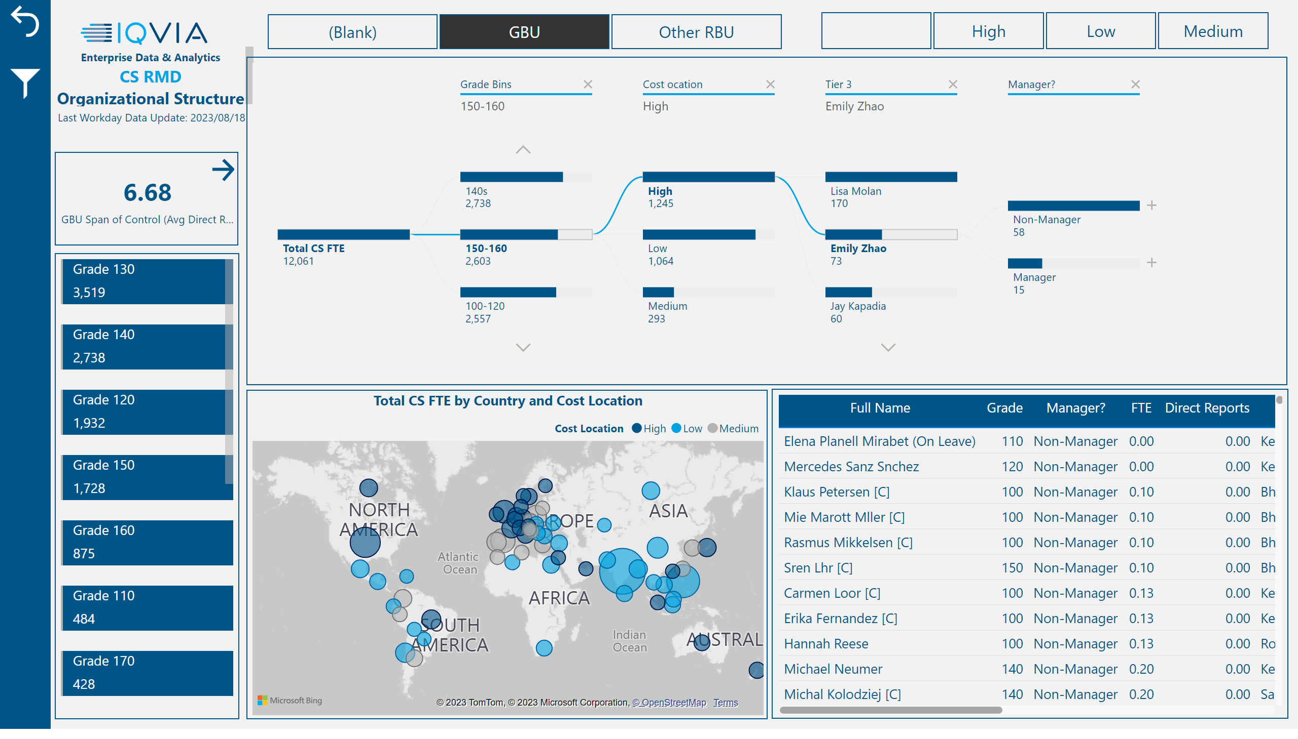
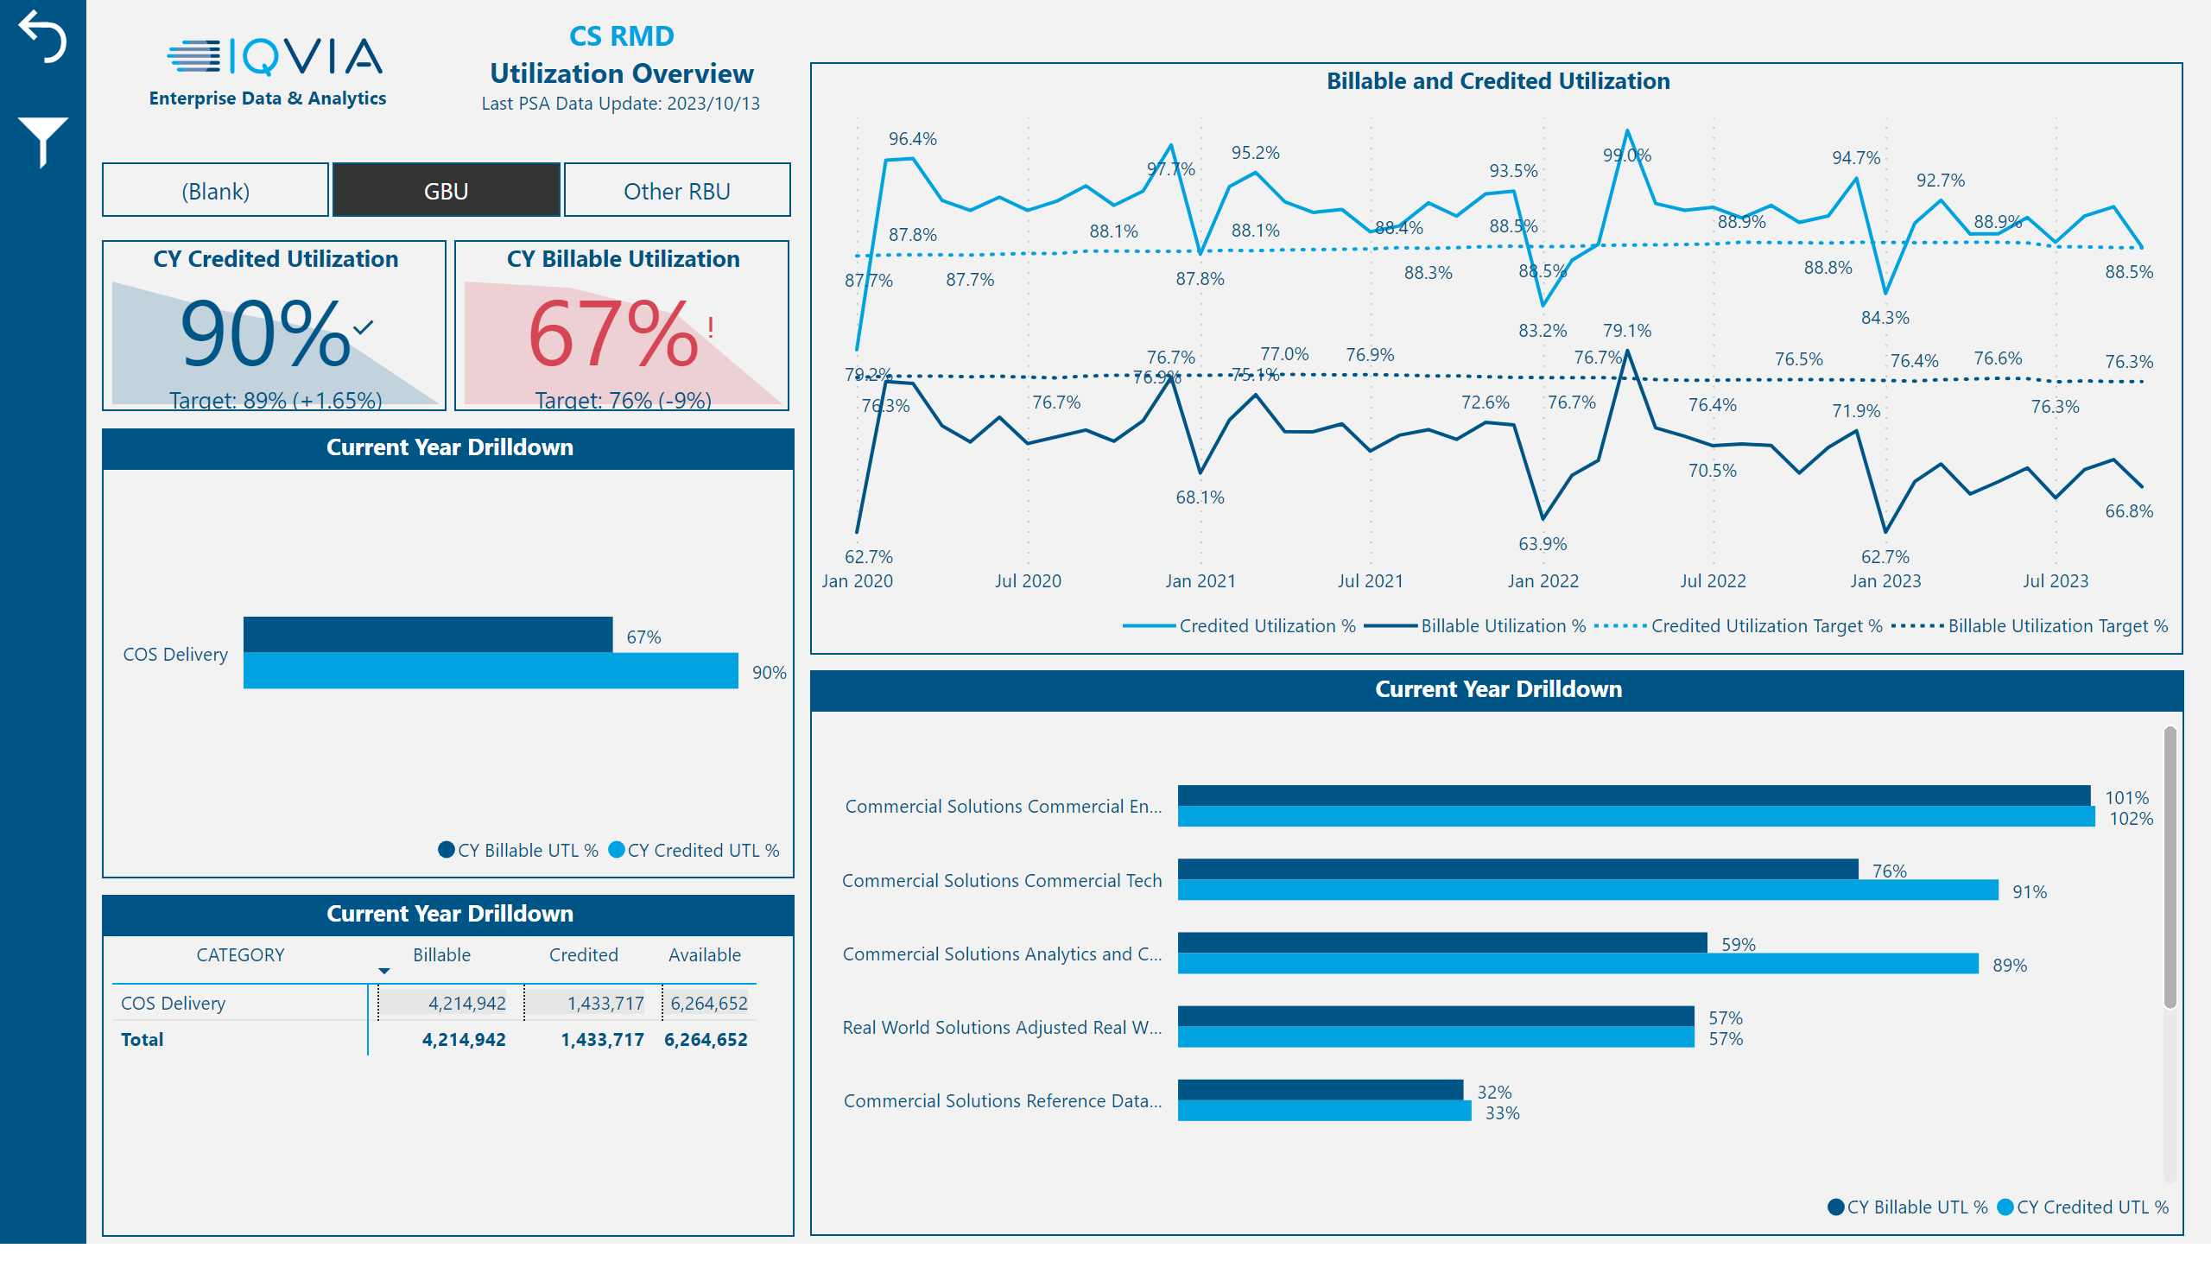
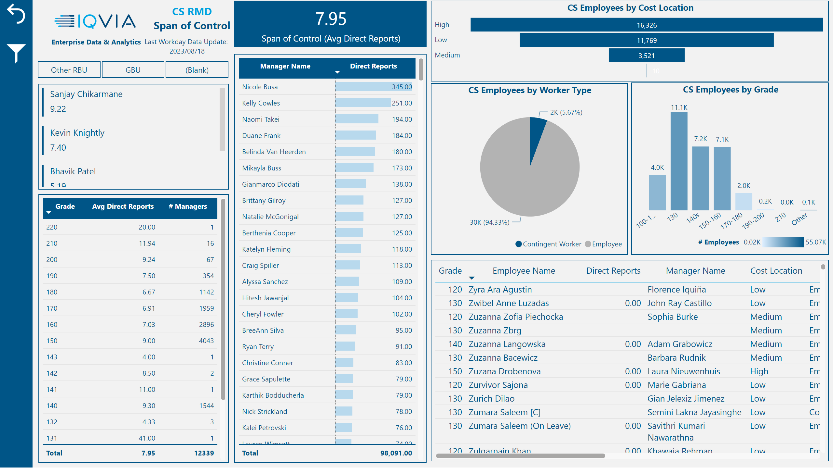
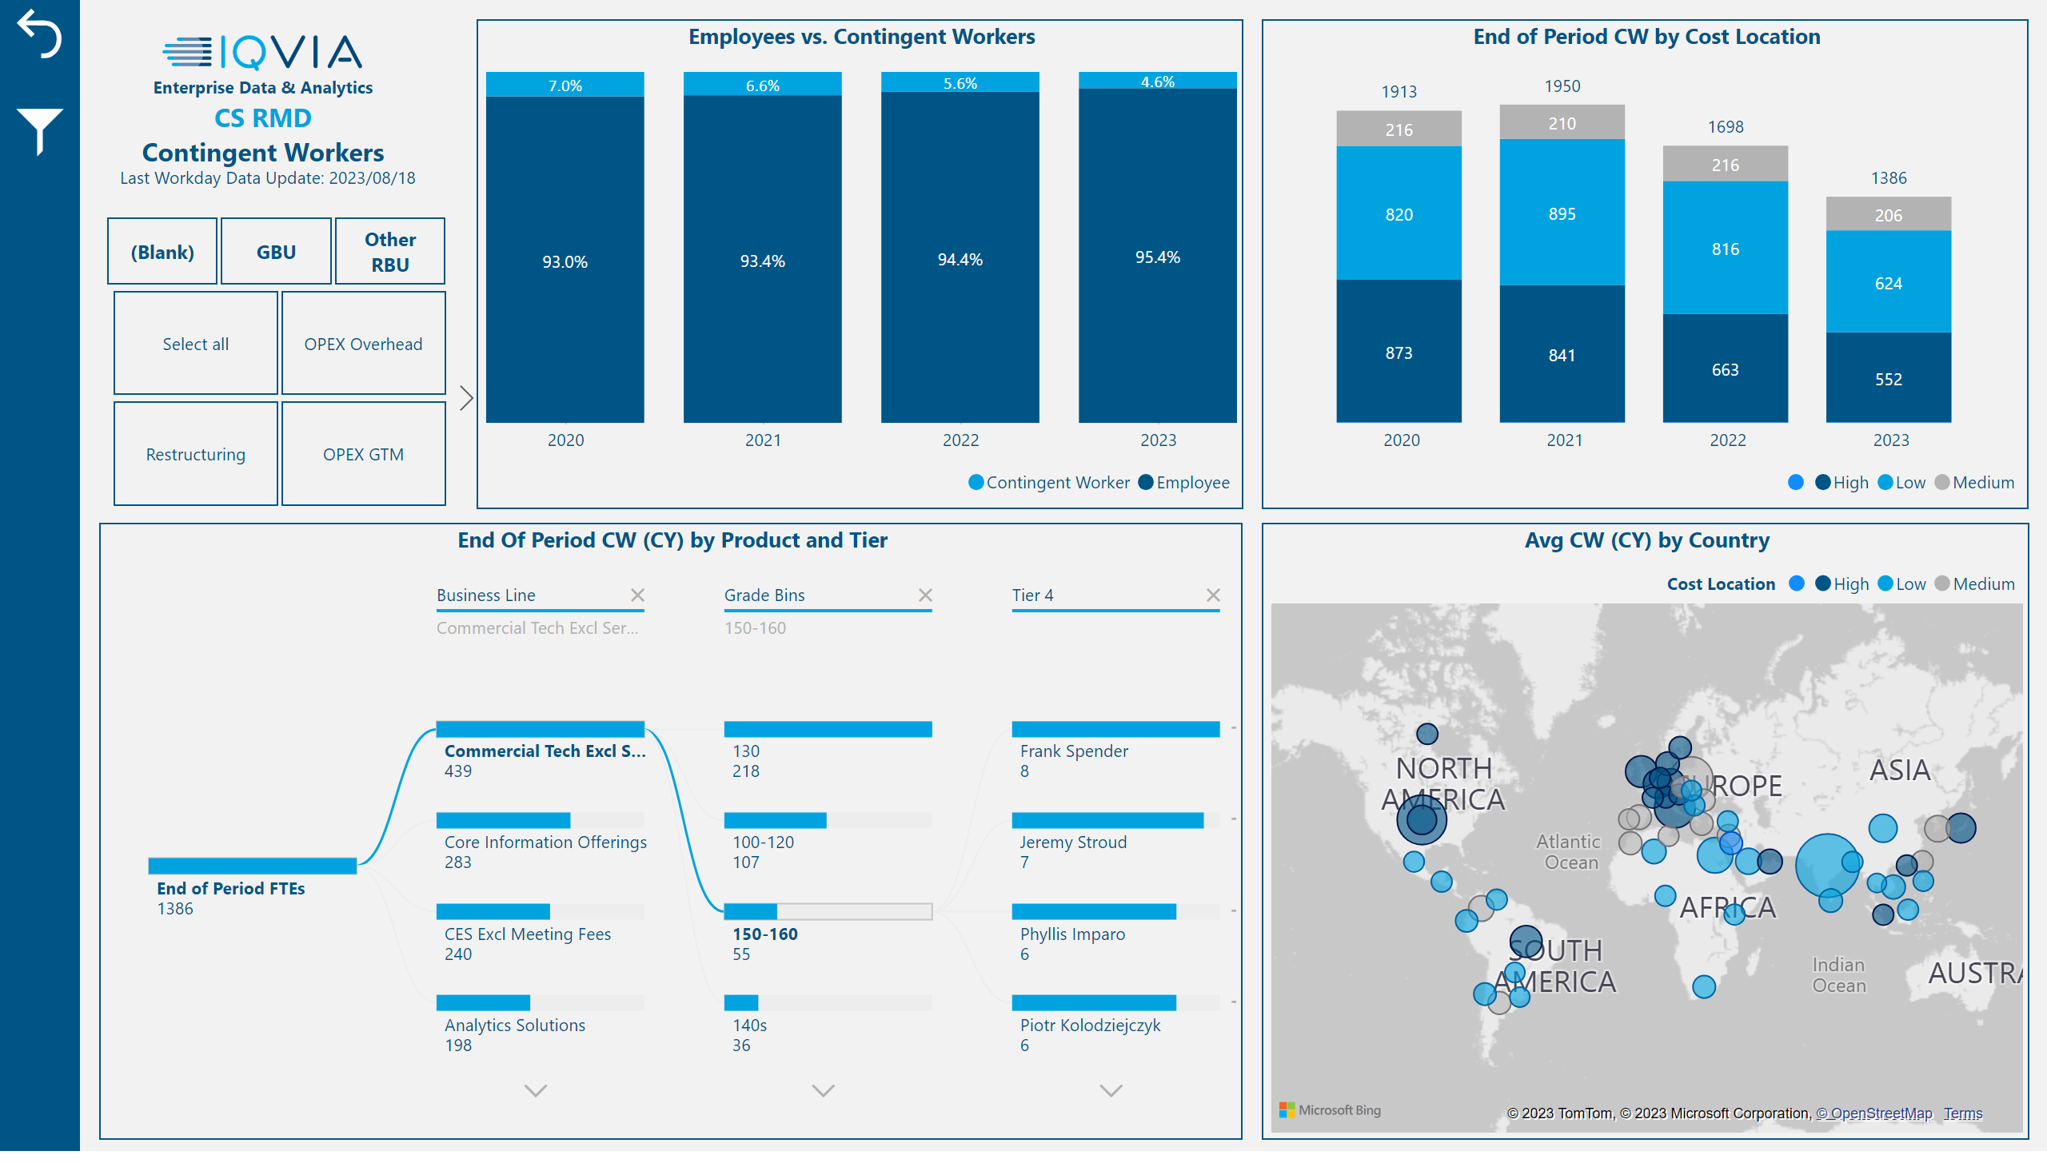
ED&A
Resource Management Dashboard
Dashboard includes analysis done by grade, cost of location, profit center & products

Slide 19
ED&A
OPEX Projects
2023

Slide 20

ED&A
USCAN Business Metrics
Project Status: Completed
BENEFITS
Consistent OPEX reporting throughout the RBU
Drive business decisions
Optimize operating expenses
Accurate data
Eliminate manual efforts to create presentations and reports
GOAL
Create an automated report that will drive consistent Operational Expenses Reporting in the US RBU, including newly defined KPIs to support performance tracking.
Data Sources
KPIs
Fee Revenue
EBITDA
Compensation
Marketing Spend
Gross Margin
3rd Party Expense
MRA
Link to Dashboard

Slide 21
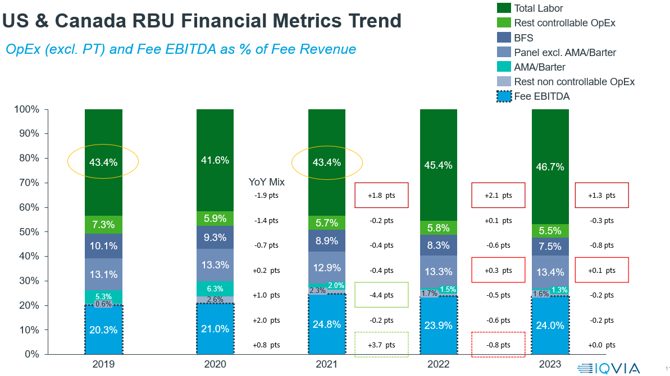
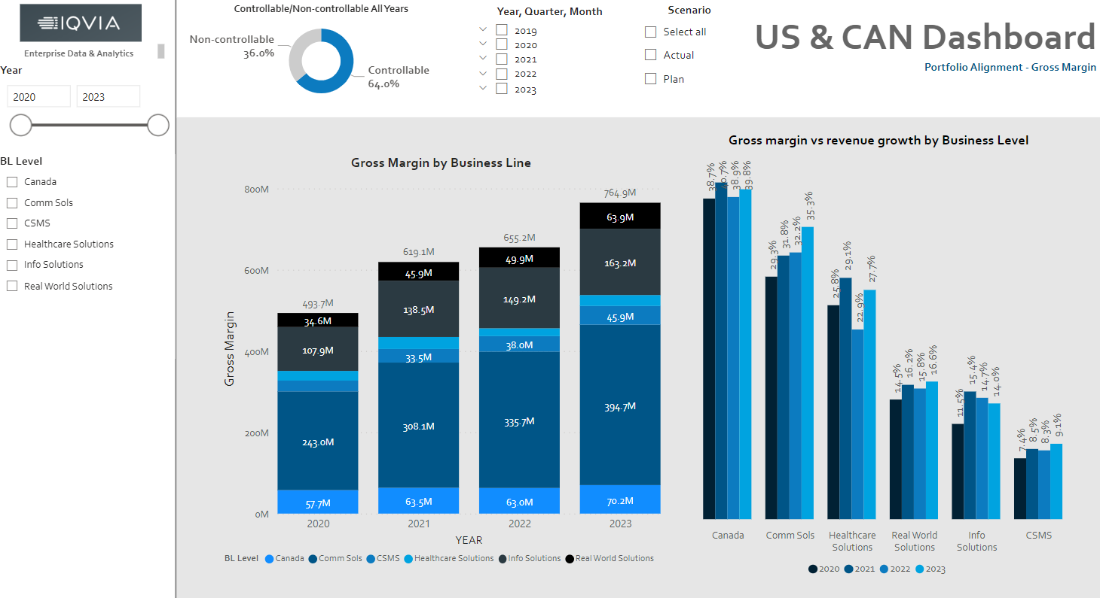
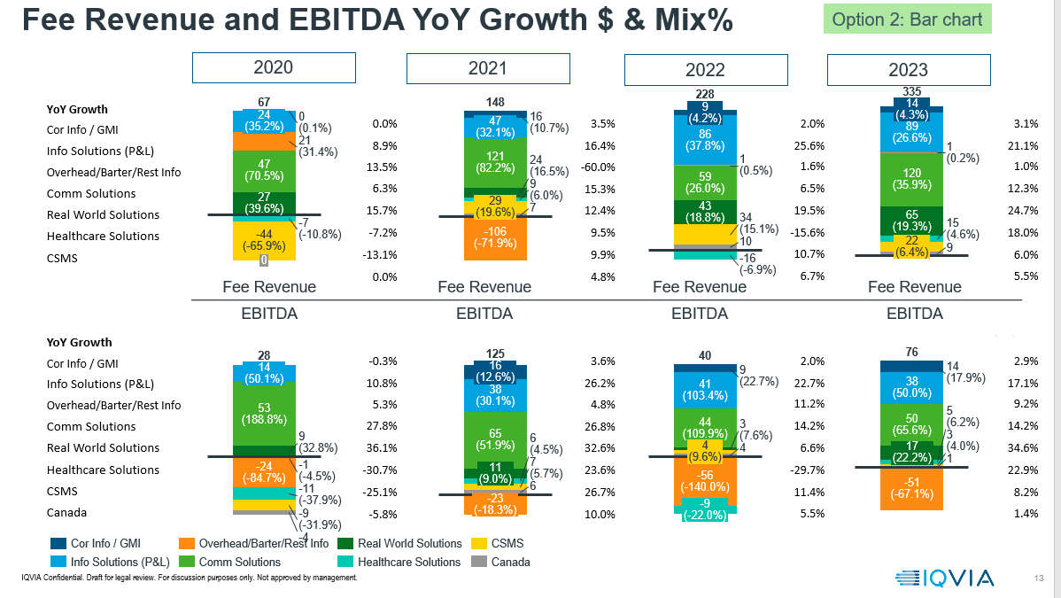
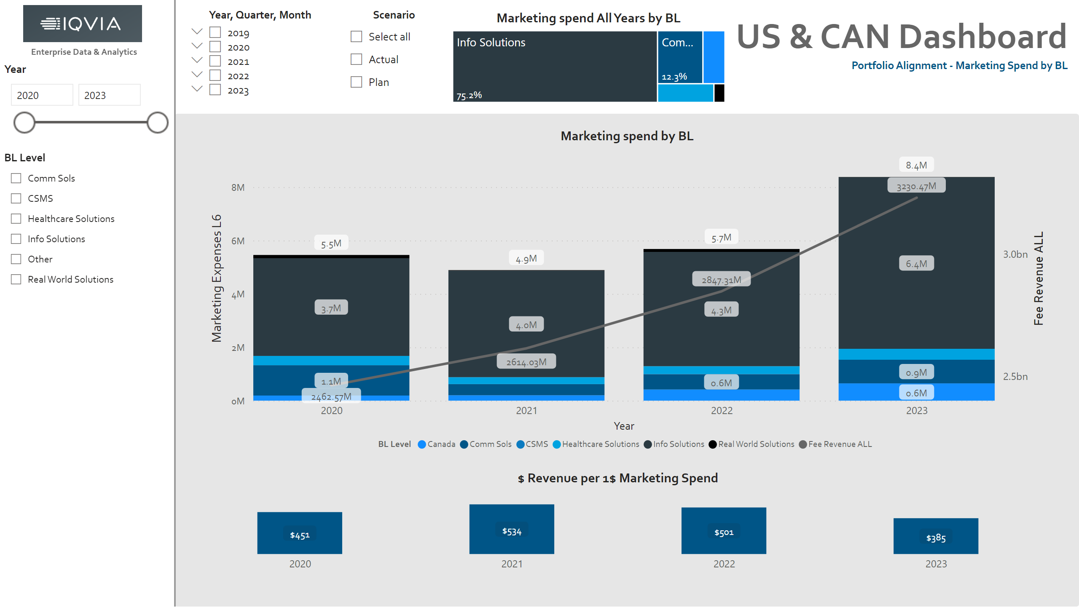
ED&A
USCAN Business Metrics
USCAN - BEFORE
USCAN AFTER

